Slide 1
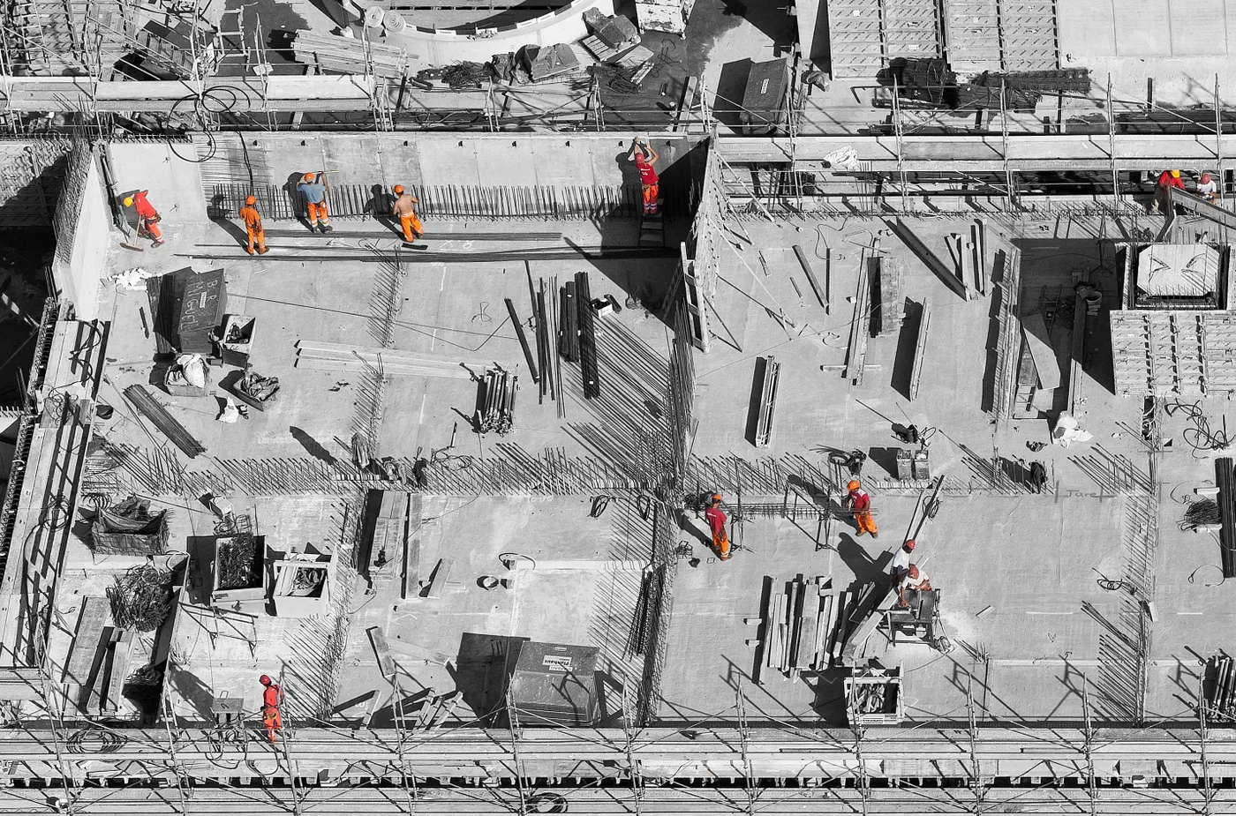
Concrete strength regression

Slide 2
Concrete Compressive Strength Prediction using Machine Learning
By
Jaydeep Chotaliya
Rohit Sankpal
Vijay Mirge
Jogendra Singh Mertiya

Slide 3
Introduction:
The Compressive Strength of Concrete determines the quality of Concrete.
Project focuses on predicting the compressive strength of concrete
Concrete is the most important material in civil engineering
Compressive strength of concrete is a highly non-linear function of age and components
Goal is to develop a machine learning model to predict compressive strength accurately

Slide 4
Dataset used for the project
The dataset for this project is related to the compressive strength of concrete. It contains information about the various components that make up the concrete mixture, such as cement, blast furnace slag, fly ash, water, superplasticizer, coarse aggregate, fine aggregate, and age. The target variable in this dataset is the compressive strength of the concrete, measured in megapascals (MPa). The goal of the project is to develop a machine learning model to accurately predict the compressive strength of concrete based on the given input variables.

Slide 5
Data Preprocessing and Exploratory Data Analysis
Importing the dataset
Checking the size of the dataset
Finding and treating missing values
Checking column types
Performing univariate analysis
Checking the distribution of numerical variables
Performing bivariate analysis
Plotting pair plots
Performing Chi-square analysis to check for the relationship between age and compressive strength
Calculating Pearson correlation and plotting their heatmap

Slide 6
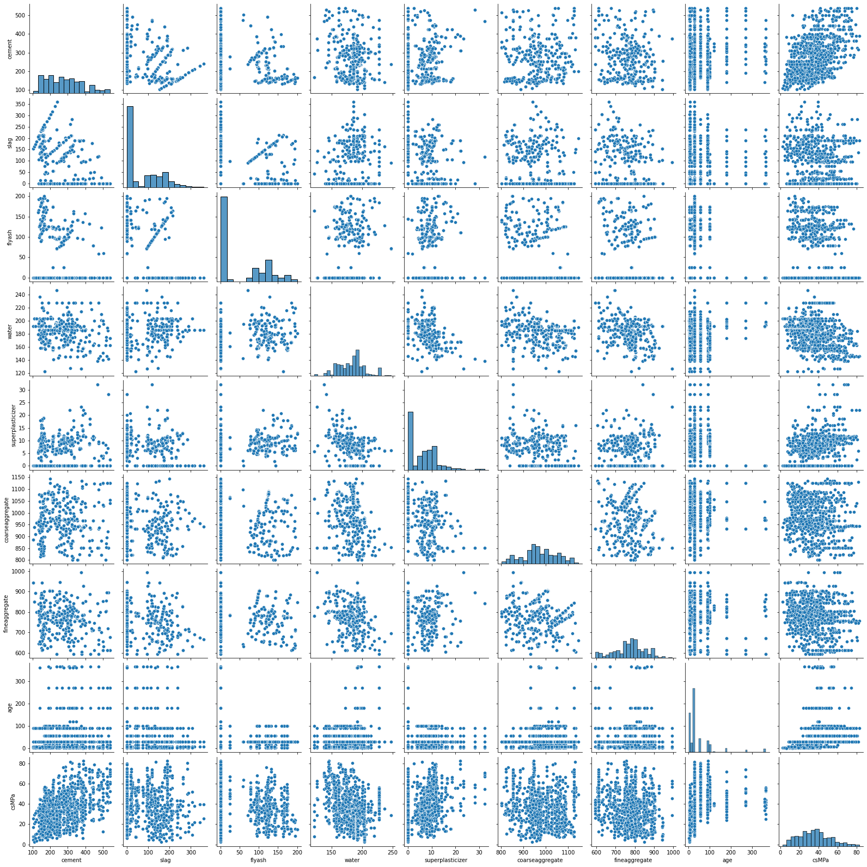
Compressive strength of concrete is a highly non-linear function of age and components

Slide 7
common challenges
Difficulty in identifying the relationship between variables: With highly non-linear relationships
Model complexity: Non-linear relationships can require more complex models to accurately capture the relationship between input and output variables. This can increase the complexity of the model and make it harder to interpret.
few things you can do
Non-linear models: here non-linear models like decision trees, random forests are best fit we can say.

Slide 8
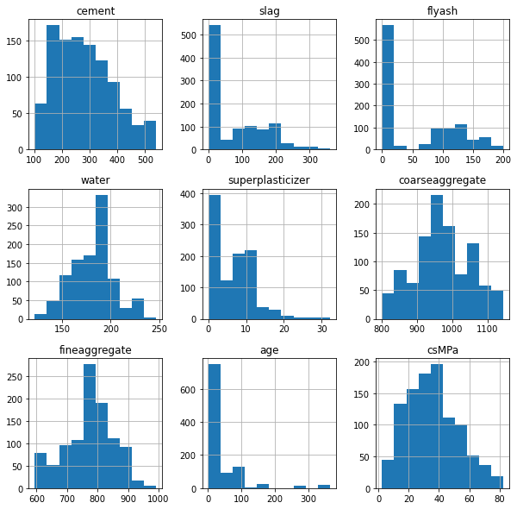
Distribution of a dataset

Slide 9
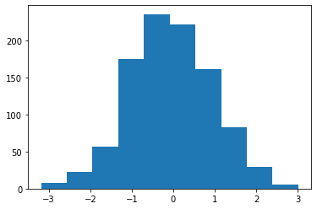
df = np.random.normal(0, 1, 1000)
plt.hist(df, bins=10)
plt.show()

Slide 10
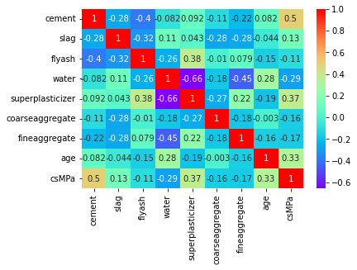
Patterns and relationships in a dataset

Slide 11
Machine Learning Models and Hyperparameter Tuning
Splitting the dataset into train and test sets
Scaling the variables
Training multiple models like Linear Regression, Decision Tree, Random Forest, and Support Vector Regression
Checking their performance using Mean Squared Error (MSE) or R-squared score
Choosing the best model
Using GridSearchCV to tune the hyperparameters of the best model

Slide 12
Conclusion
We have analysed the Compressive Strength Data and used Machine Learning to Predict the Compressive Strength of Concrete. We have used Linear Regression and its variations, Decision Trees and Random Forests to make predictions and compared their performance. Random Forest Regressor has the lowest RMSE which is 5.35 so its a good choice for this problem. Also, we can further improve the performance of the algorithm by tuning the hyperparameters by performing a grid search or random search.
RMSE LinearRegression = 10.59
RMSE DecisionTreeRegressor = 6.46
RMSE random_Forest = 5.35

Slide 13
Thank You

